Slide 1
How I learned to love Dependency Injection
James Bender
James@JamesCBender.com
https://github.com/JamesBender

Slide 2

Who the heck is this guy?
James Bender
Principal Technology Evangelist, The Sophic Group
Microsoft MVP
President, Central Ohio .NET Developers Group
Senior Editor of First Party Content, NPlus1.org
President and Chief Nerd-Herder, Columbus Architects Group
Author for Wrox Publishing
www.JamesCBender.com
james@jamescbender.com
Twitter: JamesBender

Slide 3
Why Dependency Injection?

Slide 4

The Pursuit of the Loosely Coupled System

Slide 5


Slide 6
SOLID Princples

Slide 7
SOLID Princples
Liskov Substitution Principle
Any object in your application should be able to be replaced with a type derived from it without breaking the application

Slide 8
SOLID Princples
Dependency Inversion Principle
Code should depend on abstractions; not concrete implementations. Furthermore, the abstractions should not depend on the details; the details should depend on the abstractions

Slide 9
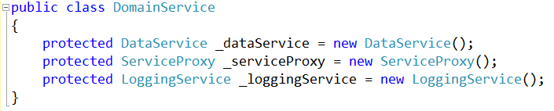
Basic Entity-Based Architecture
Database Access Service
Domain Service
Database Access Service
Service Proxy
Logging Service
Etc..
Service Proxy
Logging Service
Tightly coupled services!

Slide 10

Doesn’t promote reusability
Creates brittle systems
Difficult to “mock” makes testing difficult

Slide 11
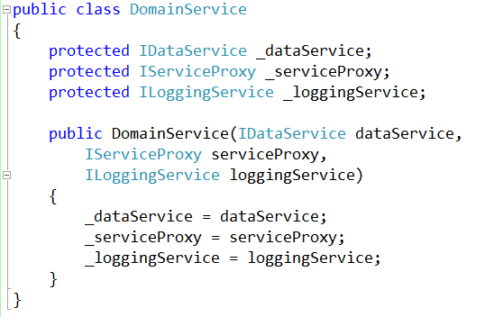
With Dependency Injection

Slide 12

Better….
… but still a lot of work
There are so many dependencies in this system, how do I manage them all?

Slide 13
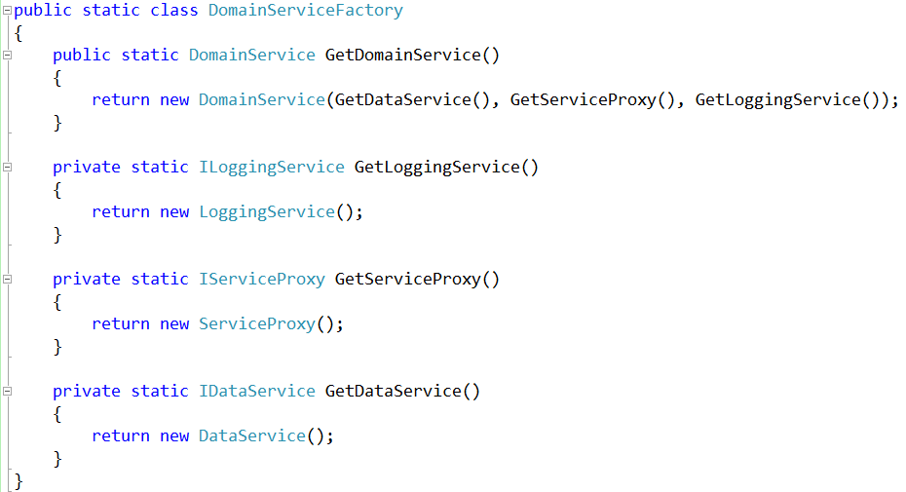
Dependency Injection With a Factory Pattern
Domain Service
“I need to be created, including have all my services crated and given to me.”
Create a
Concrete instance
Object Factory
“ I know how to build all of this stuff.”
Create an
Entity for me
Instance for
application
Application
“I need an Domain Service but I don’t how to create it.”

Slide 14
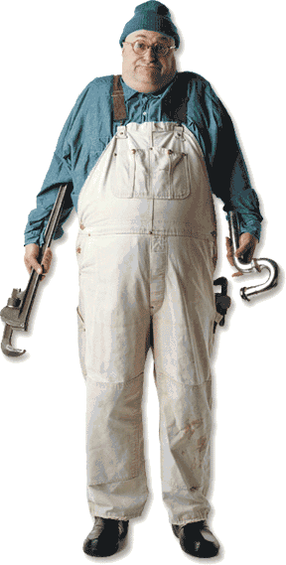
I want to spend my day writing functional business code, NOT being a plumber…

Slide 15
Dependency Injection Frameworks to the Rescue!

Slide 16
With a Dependency Injection Framework
Application
“I need a concrete instance of a Service…”
Domain Service
Database Access Service
Service Proxy
Logging Service
Etc..
Provider
“You tell me what type of object you want, I give you the object you need:”
Kernel
“You ask me for objects, I create them based on the provided mappings and rules”

Slide 17
DEMO TIME!

Slide 18
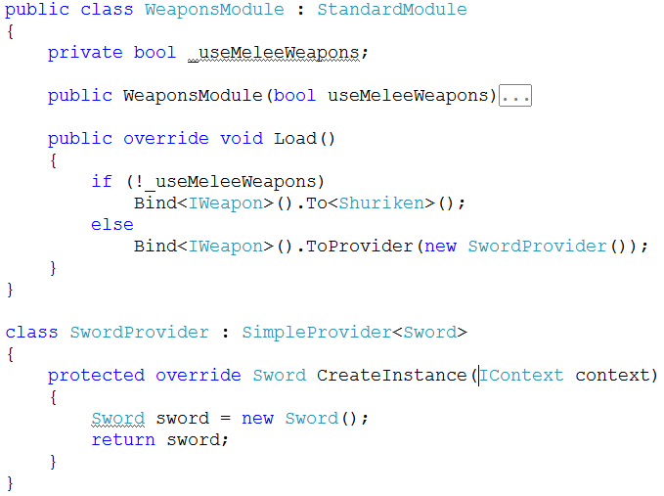
How does the Provider know what to create?

Slide 19
DEMO TIME!

Slide 20
Some Popular .NET Dependency Injection Frameworks
Structure Map
Ninject
Windsor
Microsoft Unity

Slide 21
Some helpful links…
DI Frameworks:
Ninject.org
StructureMap.Sourceforge.net
www.castleproject.org/container/index.html
Unity (tinyurl.com/cm9pe3)

Slide 22
Some helpful links…
Martin Fowler
martinfowler.com/articles/injection.html
MSDN Article on Dependency Injection pattern
http://tinyurl.com/bm8wm5
Dependency Injection tutorial
http://tinyurl.com/5fysrq

Slide 23

Professional Test Driven Development with C#

Slide 24
Thank you!
www.JamesCBender.com
https://github.com/JamesBender
james@jamescbender.com
Twitter: @JamesBender

